Slide 1


TASK-2
TOPIC–
AUTOMATIC SCANNER TO FIND AND REPORT THE CRITICAL VULNERABILITIES USING NETSPARKER TOOL
🐞 http://zero.webappsecurity.com/🐞
NAME: Naveen Kumar A
E-MAIL: naveenkumar.ct19@bitsathy.ac.in

Slide 2





WEBSITE INFORMATION
WEBSITE URL- 🐞 http://zero.webappsecurity.com/🐞
It is a real life-like web application in the form of an online bank portal.
is to test this website using NetSparker

Slide 3
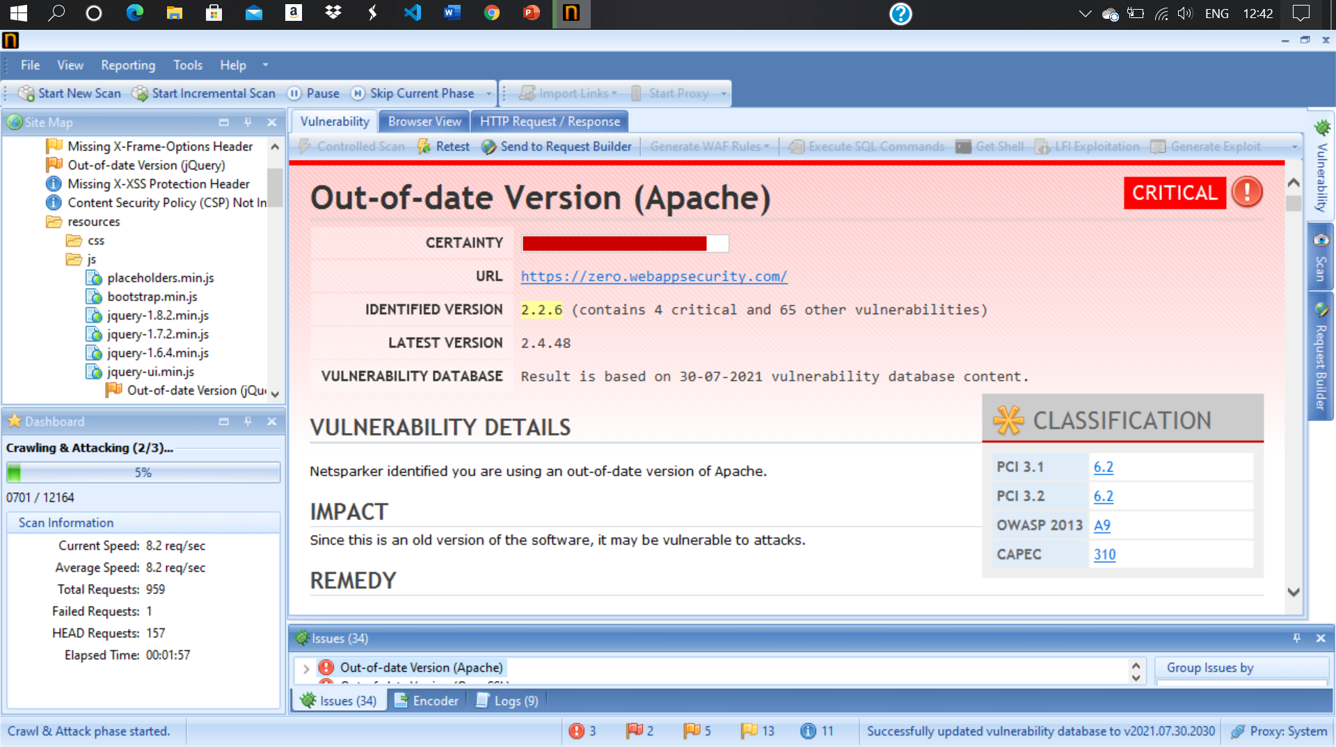
NETSPARKER REPORT

Slide 4

OWN REPORT
STEPS – http://zero.webappsecurity.com/ 🐞 🐞
Step 1: Add Website you want to s to the dialogue box.
Step 2: Define the customization option to scan as per your need
Step 3: It will start scanning it automatically
Step 4: Choose any one of the Critical Vulnerabilities.
Step 5: Write Reports for the vulnerability you wanted to write. Make sure the report should not be the same as in Netsparker.
VULNERABLE NAME => Out-of-date Version (Apache) 🐞
It detected the out-of-date-version(Apache) an CRITICAL VULNERABILITIES . It is an version of apache

Slide 5

IMPACT & REMEDY OF VULNERABLE =>
Since this is an old version of the software, it may be vulnerable to attacks.
We should upgrade your installation of Apache to the latest stable version.
The mod_cache and mod_dav modules in the Apache HTTP Server allow remote attackers to cause a denial of service (process crash) via a request that lacks a path.

Slide 6
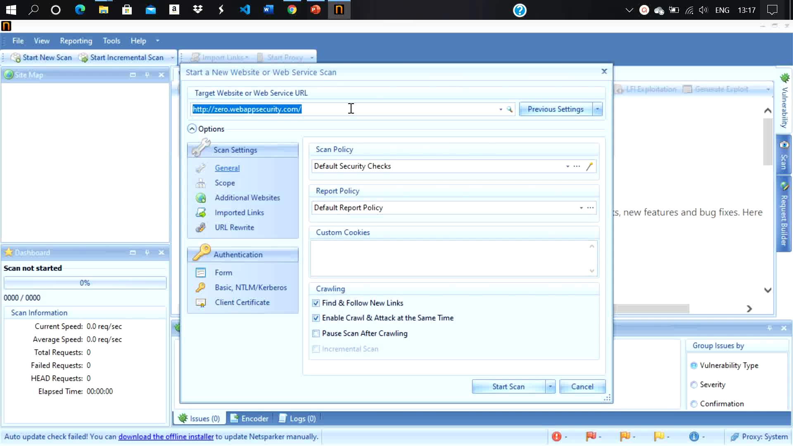
POC VEDIO

